Slide 1
CSE322
Formal Languages and Automation Theory
Lecture # 9
School of Computer Science and Engineering

Slide 2
Myhill-Nerode Theorem
Myhill-Nerode theorem is used to minimize the DFA.
Important Steps:
Draw a table for all pairs of states (P,Q)
Mark all pairs, where P ∈ F and Q ∉ F.
If there are any unmarked pair (P,Q) such that [δ (P,x), δ (Q,x)] is marked, then mark [P,Q]. Here x is input symbol.
Combine all the unmarked pairs and make them a single state.

Slide 3
Cont..
Example
Minimize given DFA, using Myhill-Nerode Theorem.
B
1
D
1
F
0,1
0
1
0
0
1
A
C
E
0
1
0

Slide 4
Cont.
For Marking pair, create a Table. First, count total number of state, then create Table for same.
 | A | B | C | D | E | F
A
B
C
D
E
F

Slide 5
Cont.
For Marking pair, create a Table. First, count total number of state, then create Table for same.
A
B
C
D
E
F
A
B
C
D
E
F

Slide 6
Cont.
Now, we will mark respective cell, If in any pair single state is final and another one is non-final, then we mark particular cell.
First Cell is AB
Both state is non-final, so we not mark.
A
B
C
D
E
F
A
B
C
D
E
F

Slide 7
Cont.
Now, we will mark respective cell, If in any pair single state is final and another one is non-final, then we mark particular cell.
Next Cell is CA
C is final state and A is not, so we mark.
A
B
C
D
E
F
A
M
B
C
D
E
F

Slide 8
Cont.
Now, we will mark respective cell, If in any pair single state is final and another one is non-final, then we mark particular cell.
Next Cell is CB
C is final state and B is not, so we mark.
A
B
C
D
E
F
A
M | M
B
C
D
E
F

Slide 9
Cont.
Now, we will mark respective cell, If in any pair single state is final and another one is non-final, then we mark particular cell.
Next Cell is DA
D is final state and A is not, so we mark.
A
B
C
D
E
F
A
M | M
M
B
C
D
E
F

Slide 10
Cont.
Now, we will mark respective cell, If in any pair, single state is final and another one is non-final, then we mark particular cell.
Next Cell is DB
D is final state and B is not, so we mark.
A
B
C
D
E
F
A
M | M
M | M
B
C
D
E
F

Slide 11
Cont.
Now, we will mark respective cell, If in any pair, single state is final and another one is non-final, then we mark particular cell.
Next Cell is DC
D is final state and C is also, so we not mark.
A
B
C
D
E
F
A
M | M
M | M
B
C
D
E
F

Slide 12
Cont.
Now, we will mark respective cell, If in any pair, single state is final and another one is non-final, then we mark particular cell.
Next Cell is EA
E is final state and A is not, so we mark.
A
B
C
D
E
F
A
M | M
M | M
M
B
C
D
E
F

Slide 13
Cont.
Now, we will mark respective cell, If in any pair, single state is final and another one is non-final, then we mark particular cell.
Next Cell is EB
E is final state and B is not, so we mark.
A
B
C
D
E
F
A
M | M
M | M
M | M
B
C
D
E
F

Slide 14
Cont.
Now, we will mark respective cell, If in any pair, single state is final and another one is non-final, then we mark particular cell.
Next Cell is EC
E is final state and C is also, so we not mark.
A
B
C
D
E
F
A
M | M
M | M
M | M
B
C
D
E
F

Slide 15
Cont.
Now, we will mark respective cell, If in any pair, single state is final and another one is non-final, then we mark particular cell.
Next Cell is ED
E is final state and D is also, so we not mark.
A
B
C
D
E
F
A
M | M
M | M
M | M
B
C
D
E
F

Slide 16
Cont.
Now, we will mark respective cell, If in any pair, single state is final and another one is non-final, then we mark particular cell.
Next Cell is FA
F is not final state and A is also, so we not mark.
A
B
C
D
E
F
A
M | M
M | M
M | M
B
C
D
E
F

Slide 17
Cont.
Now, we will mark respective cell, If in any pair, single state is final and another one is non-final, then we mark particular cell.
Next Cell is FB
F is not final state and B is also, so we not mark.
A
B
C
D
E
F
A
M | M
M | M
M | M
B
C
D
E
F

Slide 18
Cont.
Now, we will mark respective cell, If in any pair, single state is final and another one is non-final, then we mark particular cell.
Next Cell is FC
F is not final state and B is final, so we mark.
A
B
C
D
E
F
A
M | M
M | M
M | M
 |  | M
B
C
D
E
F

Slide 19
Cont.
Now, we will mark respective cell, If in any pair, single state is final and another one is non-final, then we mark particular cell.
Next Cell is FD
F is not final state and D is final, so we mark.
A
B
C
D
E
F
A
M | M
M | M
M | M
 |  | M | M
B
C
D
E
F

Slide 20
Cont.
Now, we will mark respective cell, If in any pair, single state is final and another one is non-final, then we mark particular cell.
Next Cell is FE
F is not final state and E is final, so we mark.
A
B
C
D
E
F
A
M | M
M | M
M | M
 |  | M | M | M
B
C
D
E
F

Slide 21
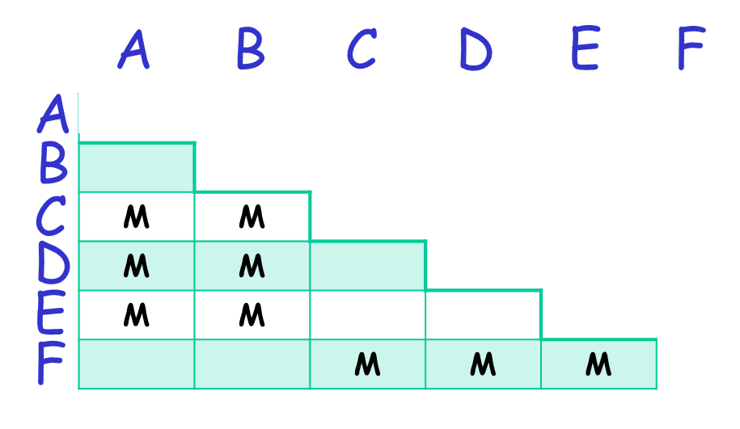
Cont.
Now, we will check for Unmarked Pair. So, here
BA, DC, EC, ED, FA and FB is unmarked pairs, There fore we check for same using transition (Including both input symbol, i.e. a and b)

Slide 22
Cont.
Now, we will check for Unmarked Pair, so first
(B,A) – δ (B,0) = A δ (B,1) = D
- δ (A,0) = B δ (A,1) = C
Here, we Check weather output Pair mark or not? If not mark then again we keep BA as unmark.

Slide 23
Cont.
Now, we will check for next Unmarked Pair, so next
(D,C) – δ (D,0) = E δ (D,1) = F
- δ (C,0) = E δ (C,1) = F
Here, we Check weather output Pair mark or not? If not mark then again we keep DC as unmark.

Slide 24
Cont.
Now, we will check for next Unmarked Pair, so next
(E,C) – δ (E,0) = E δ (E,1) = F
- δ (C,0) = E δ (C,1) = F
Here, we Check weather output Pair mark or not? If not mark then again we keep EC as unmark.

Slide 25
Cont.
Now, we will check for next Unmarked Pair, so next
(E,D) – δ (E,0) = E δ (E,1) = F
- δ (D,0) = E δ (D,1) = F
Here, we Check weather output Pair mark or not? If not mark then again we keep ED as unmark.

Slide 26
Cont.
A
B
C
D
E
F
-
A
M | M
M | M
M | M
M |  | M | M | M
B
C
D
E
F
Now, we will check for next Unmarked Pair, so next
(F,A) – δ (F,0) = F δ (F,1) = F
- δ (A,0) = B δ (A,1) = C
Here, we Check weather output Pair mark or not? Here for input 1, FC pair come and its already marked so we have to mark FA.

Slide 27
Cont.
A
B
C
D
E
F
-
A
M | M
M | M
M | M
M | M | M | M | M
B
C
D
E
F
Now, we will check for next Unmarked Pair, so next
(F,B) – δ (F,0) = F
- δ (B,0) = A
Here, we Check weather output Pair mark or not? Here for input 0, FA pair come and its already marked so we have to mark FB too.

Slide 28
Cont.
Now, we will combine all unmarked pairs, So
(A,B), (D,C), (E,C) and (E,D) are unmarked pairs.
(A,B) is in one group and both are intermediate state so we create one state for this combination.
And all other combinations are final sate, so we combined (C,D,E) in one state.
We keep remaining state, as it is. (i.e. State F)
0,1
0
0
AB
1
CDE
1
F

